Slide 1

P peline
The Data
Introductory Statistics: Correlation & Causality II
© Jennifer Mankoff & Nikola Banovic
The Data Pipeline; HCII; Spring 2017
Materials based on content from https://www.probabilitycourse.com

Slide 2
Causality
How do we infer causality?
How do we prove it?
Why is it hard to prove causality
Why do we need to prove causality?

Slide 3
Frequentist vs Bayesian Approaches
Formalizing Causality

Slide 4
Common Statistical Tests: T-Test
T-Test
Tests for difference between two samples
Best used to determine what is ‘worthy of a second look’
Limited in its applicability to normal, independent data
The more implausible the hypothesis, the greater chance that it is a ‘false alarm’
Does not help to document effect size [the actual difference between groups], just effect likelihood
Susceptible to ‘data dredging’
Varied tests looking for a significant result
Adjustments mid experiment
Notes:
changes in a few data-analysis decisions can increase the false-positive rate in a single study to 60%.

Slide 5
Two samples
p
x

Slide 6
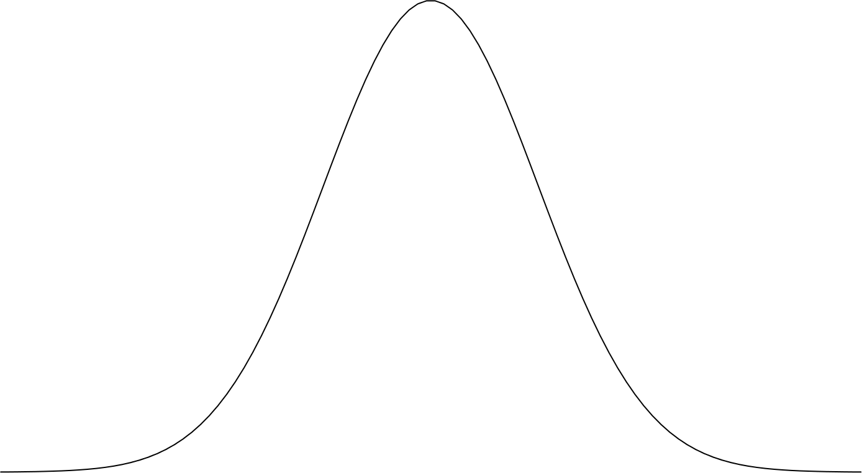
Where is the mean?
p
x

Slide 7
Where is the mean?
p
x

Slide 8
Where is the mean?
p
x

Slide 9
Where is the mean?
m₁
m₂
p
x

Slide 10
Is there a difference?
m₁
m₂
p
x

Slide 11
95% confidence interval
95% confidence interval
m₁
m₂
p
x

Slide 12
Is there a difference?
m₁
m₂
p
x

Slide 13
95% confidence interval
95% confidence interval
m₁
m₂
p
x

Slide 14
m₁
m₂
p
x

Slide 15
m₁
m₂
p
x

Slide 16
m₁
m₂
p
x

Slide 17
m₁
m₂
p
x

Slide 18
95% confidence interval
95% confidence interval
m₁
m₂
p
x

Slide 19
95% confidence interval
95% confidence interval
m₁
m₂
p
x

Slide 20
95% confidence interval
95% confidence interval
m₁
m₂
p
Effect size
x

Slide 21
m₁
m₂
p
x

Slide 22
m₁
m₂
p
x

Slide 23

What if we increase $α$?
m₁
m₂
p
x

Slide 24
What if we increase $α$?
m₁
m₂
p
x

Slide 25
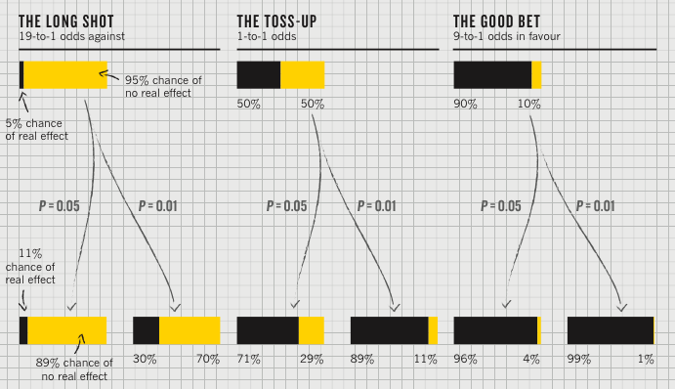
Importance of priors
P value
Best used to determine what is ‘worthy of a second look’ [Nuzzo]
Limited in its applicability

Slide 26
Plausibility of the hypothesis (inference)
P value
Best used to determine what is ‘worthy of a second look’ [Nuzzo]
Limited in its applicability
‘Prior’: Before the
experiment

Slide 27
‘Statistical significance’
P value
Best used to determine what is ‘worthy of a second look’ [Nuzzo]
Limited in its applicability
Calculated p value
Notes:
Does not incorporate the inference (the top of this chart) directly

Slide 28
Actual implications of the p-value
P value
Best used to determine what is ‘worthy of a second look’ [Nuzzo]
Limited in its applicability
Hypothesis more plausible than it should be (Type I Error)
Notes:
Does not incorporate the inference (the top of this chart) directly

Slide 29
Actual implications of the p-value
P value
Best used to determine what is ‘worthy of a second look’ [Nuzzo]
Limited in its applicability
Alternatively, a small sample may cause a Type II error (failure to detect a true difference) due to random sampling bias
Notes:
Does not incorporate the inference (the top of this chart) directly

Slide 30
What does this have to do with causality?
Example: A/B testing
What to know if A better or B better
E.g., A is stylus, B is finger
Measure speed of entering text
Split participants in two groups.
Hold everything the same, except…
Group 1 uses stylus (A); group 2 uses finger (B)
Run a null hypothesis test
Then if there is a difference in typing speed, we can say it was caused by text entry method (A/B)

Slide 31
95% confidence interval
95% confidence interval
m₁
m₂
p
Effect size
Finger
Stylus
Text entry method

Slide 32
m₂
m₁
Mean speed
Finger
Stylus
Text entry method

Slide 33
Flaws with p values
Does not tell us the likelihood something is true. It only lets us reject or accept a hyp.
Gives a yes or no answer: Either the null hypothesis is rejected (the result would be unlikely [defined by α] in a world where the null hypothesis was true) or it cannot be rejected
Doesn’t take prior knowledge into account
Based on assumed ‘average’ sample

Slide 34
Further flaws
These are estimates and we can make two kinds of errors (false positives & negatives)
These statistics depend on the central limit theorem and thus its assumptions
The sample is normal
If multiple samples, they are independent & have the same variance
Can only reject hypotheses [as discussed]
Notes:
Note: Add a little more about the last point

Slide 35
Potential Errors
 | Actually is: Same as Population | Actually is: Different than Population
Decision: is Same | H₀ (null): No difference | False negative
Decision: is Different | False positive | H₁: Real difference

Slide 36
Could our Estimate Be Wrong?
 | Actually is: Same as Population | Actually is: Different than Population
Decision: is Same | H₀ (null): No difference | False negative
Decision: is Different | False positive | H₁: Real difference
Erroneously detect a difference (Type I error). Directly affected by α: at .05 we make a Type I error 5 out of 100 tries. .01 reduces this error to 1 out of 100 tries.

Slide 37
Could our Estimate Be Wrong?
 | Actually is: Same as Population | Actually is: Different than Population
Decision: is Same | H₀ (null): No difference | False negative
Decision: is Different | False positive | H₁: Real difference
Fail to detect a true difference (Type II error) Indirectly affected by α: Depends on the size of the mean difference and the sample size.

Slide 38
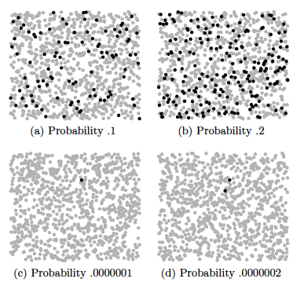
Type II errors (failure to detect difference) also caused by small effect size
S. Kleinberg (2015) Why: A Guide to Finding and Using Causes. O’Reilly Media.
Notes:
Each dot represents 10,000 events, except in the lower two figures, where black
dots are single events.
Is this a problem?

Slide 39
False positive and negative Error Tradeoffs
Suppose there is a test for a particular disease (H₀ is that the person is disease free)
If the person is sick and is diagnosed early, she can be successfully treated
If it is not diagnosed and treated, the person will become severely disabled
If a person is erroneously diagnosed as having the disease and treated, no physical damage is done.
To which type of error you are willing to risk ?

Slide 40
Could our Estimate Be Wrong?
 | No Disease | Disease
Not Diagnosed | OK | False negative
Diagnosed | False positive | Ok

Slide 41
Could our Estimate Be Wrong?
 | No Disease | Disease
Not Diagnosed | OK | False negative
Diagnosed | False positive | Ok
Not treated; irreparable damage is done
Treated, but not harmed by treatment
Decision: to reduce the chance of false negatives (Type II errors), increase α (e.g. from .01 to .05)

Slide 42
Testing of hypotheses False positives & negatives
The probability of making a Type II error (β) can be decreased by increasing the level of significance (α).
it will increase the chance of false positives (Type I errors)

Slide 43
Testing of hypotheses False positives & negatives: Example
Suppose there is a test for a particular disease (H₀ is that the person is disease free)
If the person is sick and is diagnosed early, she can be successfully treated
If it is not diagnosed and treated, the person will eventually heal, but may lose some work days
If a person is erroneously diagnosed as having the disease and treated, serious damage may be done.
To which type of error you are willing to risk ?

Slide 44
Could our Estimate Be Wrong?
 | No Disease | Disease
Not Diagnosed | OK | False negative
Diagnosed | False positive | Ok
Minor loss of work days
Treated, harmed by treatment
Decision: to reduce the chance of false positives (Type I errors), decrease α (e.g. from .05 to .01)

Slide 45
Testing of hypotheses False positives & negatives
there is only 5 chance in 100 that the result termed "significant" could occur by chance alone
α =0.05
The probability of making a Type I error can be decreased by further reducing α
it will be more difficult to find a significant result
the power of the test will be decreased
the risk of false negatives will be increased

Slide 46
Types of errors
Potential Pitfalls typically leading to Type I errors
Low rate of replication of findings [Ionnadis]
Bias (‘findings’ may actually be measuring bias) [Ionnadis]
Lack of careful data exploration (charts & summarization) [Hart]
Potential Pitfalls leading to Type II Errors
Low power (probability of rejecting a false hypothesis i.e. Type II errors) in studies [Colquhuon]
Notes:
Note: Add a little more about the last point
Start with process data and analysis, only then explore frequency data and analysis
Interpreting results must be done with respect to real world expectations about the population

Slide 47
Beyond Binary Hypothesis Testing
What was role of cause in effect’s occurrence?
Anne drives drunk and crashes car. What’s significance of her drinking for the crash?
Could be
Because of
Despite
Independently of

Slide 48
Four relations
Despite
y is Y despite x if the probability of Y is lowered after x_{t’}
Because
y is Y because of x if the probability of Y is increased after x_{t’} and remains increased until y_{t}
Autonomously
y is Y autonomously of x if the probability of Y changes at x_{t’}, this probability is high, but then decreases before y_{t}
Independently
y is Y independently of x if the probability of Y is the same just after x_{t’} as it is just before x_{t’}

Slide 49
Caveats
How can we know all the important factors?
How can we find the probability trajectory?

Slide 50
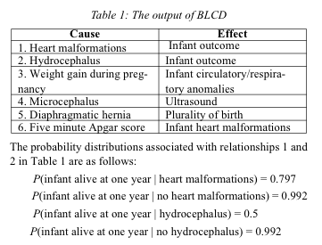
Example: infant mortality
n binary variables = 2^n entries
Mani, S., & Cooper, G. F. (2004). Causal Discovery Using a Bayesian Local Causal Discovery Algorithm. Proceedings of MedInfo, 731-735

Slide 51
Graphical model
Describes independencies in a set of variables

Slide 52
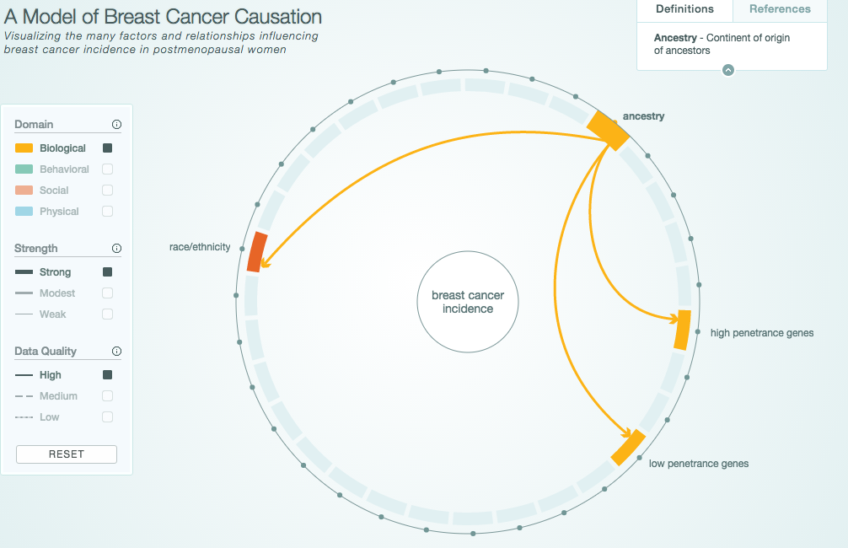
Graphical Model Example
http://www.cabreastcancer.org/causes/#

Slide 53
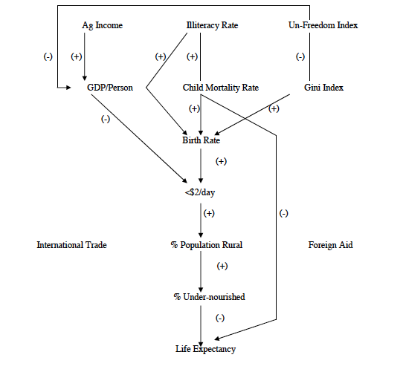
Application: Causes and effects of poverty
Bessler, D. A. (2003). On world poverty: Its causes and effects. Food and Agricultural Organization (FAO) of the United Nations, Research Bulletin, Rome

Slide 54
Graphical models and explanation
Graphical model that represents relationships between variables
Observations give truth value of variables in particular scenario
Use model to evaluate counterfactual queries

Slide 55
Example things to beware of
Sample size
Missing data (not just variables)
What structures DAG can/cannot represent (e.g. time series and feedback)

Slide 56
Summary
A cause implies that one event is dependent on one or more other events in some way (at least some of the time)

Slide 57
Summary
A cause implies interdependence
Assuming you have measured the right variables, a scatterplot/correlation can sometimes show that such a relationship exists (but not what the direction of the relationship is)

Slide 58
Summary
A cause implies interdependence
Scatterplots/correlation can highlight the existence of such relationships (but not prove causality)
T-tests typical of ‘frequency’ reasoning, are susceptible to error, and give limited information

Slide 59
Summary
A cause implies interdependence
Scatterplots/correlation can highlight the existence of such relationships (but not prove causality)
T-tests are limited, and based on frequency data
A theory of the world (process data) can improve the quality of your results and give probabilities rather than yes/no results

Slide 60
Bayesian Approaches

Slide 61

Great book ,wrong language

Slide 62
Basic steps
Identify the data relevant to the question
Measurement scales
Variables to be predicted
Predictors
Example: weight given height
Notes:
Sound familiar?

Slide 63
Basic steps
Identify the data relevant to the question
Define a descriptive model for the relevant data
graphical model
appropriate theoretical underpinnings
Example: ŷ = β₁x+β₀ and y ~ normal(ŷ, σ)
Where ŷ = predicted weight and x = height and y = actual weights. y values near ŷ may be considered most probable
Can fit this using regression
Notes:
Makes sense to me… requires you to really think about your problom

Slide 64
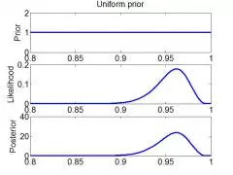
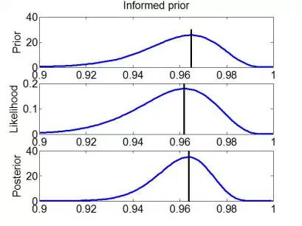
Basic steps
Identify the data relevant to the question
Define a descriptive model for the relevant data
Specify a prior distribution
Notes:
Requires research!

Slide 65
Basic steps
Identify the data relevant to the question
Define a descriptive model for the relevant data
Specify a prior distribution
Estimate the posterior distribution
Re-allocate credibility across parameter values (using Bayesian inference: solve for θ)
P(θ|D) = p(D|θ) p(θ) / p(D)
Where p(D) = ∫dθ*p(D|θ*)p(θ*)
In our example: θ includes β₁β₀ and σ
posterior likelihood prior evidence
Notes:
θ^{* is distinct from} θ – it represents all values the parameters can take on rather than a single value. -- average likelihood, or evidence. A sum for discrete θ, an integral otherwise.

Slide 66
Priors

Slide 67
Creating the posterior distribution
Estimate distribution of values for parameters consistent with the data
In our example, β₁, β₀ and σ
Most credible value for slope is maximum of distribution (4.1)
Can calculate the ‘high density interval’ (HDI) (95% of the distribution)
Notes:
Requires research!

Slide 68
Basic steps
Identify the data relevant to the question
Define a descriptive model for the relevant data
Specify a prior distribution
Estimate the posterior distribution
Check the model (randomly generate simulated y values at selected x values many many times)

Slide 69
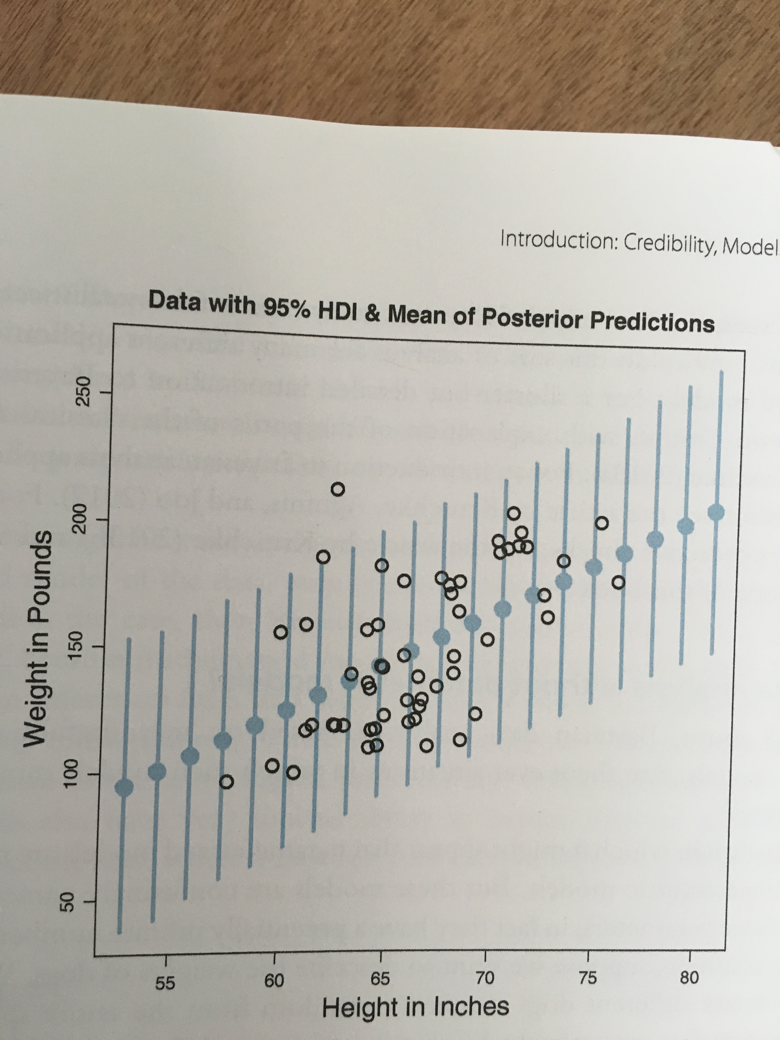
Basic steps
Identify the data relevant to the question
Define a descriptive model for the relevant data
Specify a prior distribution
Estimate the posterior distribution
Check the model (randomly generate simulated y values at selected x values many many times)
Notes:
Simulation … helps us to asses credibility. Dot shows the mean of the predicted values.

Slide 70
m₁
m₂
p
x

Slide 71
An example
A clinician developed a test for a disease
The hit rate is 99%, meaning P(+ | sick) = .99
False alarm rate is .5%, meaning P(+ | healthy) = .005
A patient’s test comes back positive. Do you treat?

Slide 72
An example
Test Result | Disease |  | Marginal (test result)
T= + 99% hit rate ½ % false pos
T = -
Marginal(disease) | P(sick) = .o1 | P(healthy) = 1 - .01 | 1
Notes:
Base rate of disease: .001
Test ‘hit rate’ is 99%
False alarm rate: ½ %

Slide 73
An example
Test Result | Disease |  | Marginal (test result)
T= + 99% hit rate ½ % false pos | P(+|sick)p(sick) = .99 * .01 | P(+|healthy)(p(healthy) = .005 * (1 - .01) | = ∑p(+|θ)p(θ)
T = - | P(-|sick)p(sick) = (1 – .99) * .01 | P(-|healthy)p(healthy) = (1 - .005) * (1 - .01) | = ∑p(-|θ)p(θ)
Marginal(disease) | P(sick) = .01 | P(healthy) = 1 - .01 | 1
Notes:
Base rate of disease: .001

Slide 74
An example
Test Result | Disease |  | Marginal (test result)
T= + 99% hit rate ½ % false pos | P(+|sick)p(sick) = .99 * .01 | P(+|healthy)(p(healthy) = .005 * (1 - .01) | = ∑p(+|θ)p(θ)
T = - | P(-|sick)p(sick) = (1 – .99) * .01 | P(-|healthy)p(healthy) = (1 - .005) * (1 - .01) | = ∑p(-|θ)p(θ)
Marginal(disease) | P(sick) = .01 | P(healthy) = 1 - .01 | 1
P(+|θ=sick) p (θ=sick)
.99*.01
P(θ=sick|+) = = = .6666
∑p(+|θ)p(θ)
.99*.1 + .005*(1-.01)
Notes:
Base rate of disease: .001

Slide 75
Reconsidering what we know about disease
Test Result | Disease |  | Marginal (test result)
T= + 99% hit rate ½ % false pos
T = -
Marginal(disease) | P(sick) = .001 | P(healthy) = 1 - .001 | 1
Notes:
Base rate of disease: .001
Test ‘hit rate’ is 99%
False alarm rate: ½ %

Slide 76
Reconsidering what we know about disease
Test Result | Disease |  | Marginal (test result)
T= + 99% hit rate ½ % false pos | P(+|sick)p(sick) = .99 * .001 | P(+|healthy)(p(healthy) = .005 * (1 - .001) | = ∑p(+|θ)p(θ)
T = - | P(-|sick)p(sick) = (1 – .99) * .001 | P(-|healthy)p(healthy) = (1 - .005) * (1 - .001) | = ∑p(-|θ)p(θ)
Marginal(disease) | P(sick) = .001 | P(healthy) = 1 - .001 | 1
Notes:
Base rate of disease: .001

Slide 77
Reconsidering what we know about disease: The impact of priors
Test Result | Disease |  | Marginal (test result)
T= + 99% hit rate ½ % false pos | P(+|sick)p(sick) = .99 * .001 | P(+|healthy)(p(healthy) = .005 * (1 - .001) | = ∑p(+|θ)p(θ)
T = - | P(-|sick)p(sick) = (1 – .99) * .001 | P(-|healthy)p(healthy) = (1 - .005) * (1 - .001) | = ∑p(-|θ)p(θ)
Marginal(disease) | P(sick) = .001 | P(healthy) = 1 - .001 | 1
P(+|θ=sick) p (θ=sick)
.99*.001
P(θ=sick|+) = = = .1654
∑p(+|θ)p(θ)
.99*.001 + .05*(1-.001)
Notes:
1.9% !!! This is the importance of priors

Slide 78
Solving for θ
Numerical approximation (sum over many discrete representative values instead of interval)
Randomly sampling a large number of representative combinations of parameter values from the posterior distribution (Markov chain Monte Carlo methods)
Regression

Slide 79
Statistical Regression Analysis
Regression analysis is used to:
Predict the value of a dependent variable based on the value of at least one independent variable
Explain the impact of changes in an independent variable on the dependent variable
Dependent variable: the variable we wish to explain
Independent variable: the variable used to do so
Adapted from http://www.fordham.edu/economics/Vinod/correl-regr.ppt

Slide 80
Relationship with correlation
In correlation, the two variables are treated as equals.
In regression, one variable is considered independent (=predictor) variable (X) and the other the dependent (=outcome) variable Y.

Slide 81
Regression in Machine Learning
Regression analysis is used to:
Predict the value of a continues variable based on the value of one or more features
Dependent variable: the outcome we wish to predict
Features: summaries of information about things we measured that should predict the outcome

Slide 82
Simple Linear Regression Model
Only one independent variable, x
Relationship between x and y is described by a linear function
Changes in y are assumed to be caused by changes in x
Adapted from http://www.fordham.edu/economics/Vinod/correl-regr.ppt

Slide 83
Population Linear Regression
The population regression model:
Population Slope Coefficient
Random Error term, or residual
Population y intercept
Independent Variable
Dependent Variable
Linear component
Random Error
component
Adapted from http://www.fordham.edu/economics/Vinod/correl-regr.ppt

Slide 84
Population Linear Regression
y
Observed Value of y for x_{i}
Random Error for x_{i}
ε_{i}
Slope = β₁
Predicted Value of y for x_{i}
Regression Line
Intercept = β₀
x_{i}
x
Adapted from http://www.fordham.edu/economics/Vinod/correl-regr.ppt

Slide 85
Estimated Regression Model
y
Estimated Intercept = b₀
Estimated Regression Line
Estimated Slope = b₁
x
Notes:
Is this any good? How do you know?

Slide 86
Better Estimate
y
Random Error for x_{i}
e_{i}
b₁
b₀
x
x
Notes:
Better?

Slide 87
Estimated Regression Model
y
Observed y for x_{i}
Random Error for x_{i}
e_{i}
b₁
Predicted for x_{i}
b₀
x
x_{i}
x
The individual random error terms e_{i} have a mean of zero
Notes:
We need to solve for y by estimating b0 and b1
b₀ is the estimated average value of y when the value of x is zero
b₁ is the estimated change in the average value of y as a result of a one-unit change in x
The simple regression line always passes through the mean of the y variable and the mean of the x variable

Slide 88
Least Squares Criterion
b₀ and b₁ must minimize
y
e_{i}
Estimated Slope = b₁
Intercept = b₀
x

Slide 89
Least Squares Criterion
b₀ and b₁ must minimize
y
Observed Value of y for x_{i}
e_{i}
Estimated Slope = b₁
Predicted Value for x_{i}
Intercept = b₀
x
Notes:
Note we can replace y-cap with b0 – b1x

Slide 90
Least Squares Criterion
b₀ and b₁ must minimize
Adapted from http://www.fordham.edu/economics/Vinod/correl-regr.ppt
Notes:
Note we can replace y-cap with b0 – b1x

Slide 91
Least Squares Regression Properties
The sum of the residuals from the least squares regression line is 0.
The sum of the squared residuals is a minimum.
The simple regression line always passes through the mean of the y variable and the mean of the x variable.
The least squares coefficients are unbiased estimates of β₀ and β₁.
Adapted from www.clt.astate.edu/asyamil/groebner/ppts/PP11final.ppt

Slide 92
Linear Regression Assumptions
Error values (ε) are statistically independent
Error values are normally distributed for any given value of x
The probability distribution of the errors is normal
The probability distribution of the errors has constant variance
The underlying relationship between the x variable and the y variable is linear
Adapted from www.clt.astate.edu/asyamil/groebner/ppts/PP11final.ppt
Notes:
In machine learning we can play with these a bit – will get to this next week

Slide 93
Simple Linear Regression Example
A real estate agent wishes to examine the relationship between the selling price of a home and its size (measured in square feet)
A random sample of 10 houses is selected
Dependent variable (y) = house price in $1000s
Independent variable (x) = square feet
Adapted from http://www.fordham.edu/economics/Vinod/correl-regr.ppt

Slide 94
Sample Data for House Price Model
House Price in $1000s (y) | Square Feet (x)
245 | 1400
312 | 1600
279 | 1700
308 | 1875
199 | 1100
219 | 1550
405 | 2350
324 | 2450
319 | 1425
255 | 1700
Adapted from http://www.fordham.edu/economics/Vinod/correl-regr.ppt

Slide 95
Graphical Presentation
House price model: scatter plot and regression line
Slope
= 0.10977
Intercept
= 98.248
Adapted from http://www.fordham.edu/economics/Vinod/correl-regr.ppt
Notes:
Here, no houses had 0 square feet, so b₀ = 98.24833 just indicates that, for houses within the range of sizes observed, $98,248.33 is the portion of the house price not explained by square feet

Slide 96
Graphical Presentation
House price model: scatter plot and regression line
Slope
= 0.10977
Intercept
= 98.248
Adapted from http://www.fordham.edu/economics/Vinod/correl-regr.ppt

Slide 97
Graphical Presentation
House price model: scatter plot and regression line
Slope
= 0.10977
Intercept
= 98.248
Adapted from http://www.fordham.edu/economics/Vinod/correl-regr.ppt
Notes:
Here, b₁ = .10977 tells us that the average value of a house increases by .10977($1000) = $109.77, on average, for each additional one square foot of size

Slide 98
Example: House Prices
Estimated Regression Equation:
House Price in $1000s (y) | Square Feet (x)
245 | 1400
312 | 1600
279 | 1700
308 | 1875
199 | 1100
219 | 1550
405 | 2350
324 | 2450
319 | 1425
255 | 1700
Predict the price for a house with 2000 square feet
Adapted from http://www.fordham.edu/economics/Vinod/correl-regr.ppt

Slide 99
Example: House Prices
Estimated Regression Equation:
House Price in $1000s (y) | Square Feet (x)
245 | 1400
312 | 1600
279 | 1700
308 | 1875
199 | 1100
219 | 1550
405 | 2350
324 | 2450
319 | 1425
255 | 1700
Predict the price for a house with 2000 square feet
Adapted from http://www.fordham.edu/economics/Vinod/correl-regr.ppt

Slide 100
Example: House Prices
Estimated Regression Equation:
House Price in $1000s (y) | Square Feet (x)
245 | 1400
312 | 1600
279 | 1700
308 | 1875
199 | 1100
219 | 1550
405 | 2350
324 | 2450
319 | 1425
255 | 1700
Predict the price for a house with 2000 square feet
The predicted price for a house with 2000 square feet is 317.85($1,000s) = $317,850
Adapted from http://www.fordham.edu/economics/Vinod/correl-regr.ppt

Slide 101
Coefficient of Determination
after minimizing

Slide 102
Explained and Unexplained Variation
(continued)
y
y_{i}
∧
∧
SSE = ∑(y_{i} - y_{i} )²
y
_
SST = ∑(y_{i} - y)²
∧
y
_
∧
_
SSR = ∑(y_{i} - y)²
_
y
y
x
X_{i}

Slide 103
Explained and Unexplained Variation
SSE = Error sum of squares. Variation attributable to factors other than the relationship between x and y
(continued)
y
y_{i}
∧
∧
SSE = ∑(y_{i} - y_{i} )²
y
_
SST = ∑(y_{i} - y)²
∧
y
_
∧
_
SSR = ∑(y_{i} - y)²
_
y
y
x
X_{i}

Slide 104
Unexplained error in House Price Model (SSE)
Unexplained variation makes R² .581
Intercept
= 98.248
Notes:
Here, b₁ = .10977 tells us that the average value of a house increases by .10977($1000) = $109.77, on average, for each additional one square foot of size

Slide 105
Explained and Unexplained Variation
SSE = Error sum of squares. Used to calculate Standard Error of regression
(continued)
y
y_{i}
∧
∧
SSE = ∑(y_{i} - y_{i} )²
y
_
SST = ∑(y_{i} - y)²
∧
y
_
∧
_
SSR = ∑(y_{i} - y)²
_
y
y
x
X_{i}

Slide 106
Standard Error of Estimate
The standard deviation of the variation of observations around the regression line is estimated by
Where
SSE = Sum of squares error
n = Sample size
k = number of independent variables in the model
Adapted from http://www.fordham.edu/economics/Vinod/correl-regr.ppt

Slide 107
Explained and Unexplained Variation
SST = Total sum of squares. Used for R². Measures the variation of the y_{i} values around their mean y
(continued)
y
y_{i}
∧
∧
SSE = ∑(y_{i} - y_{i} )²
y
_
SST = ∑(y_{i} - y)²
∧
y
_
∧
_
SSR = ∑(y_{i} - y)²
_
y
y
SSR = Regression sum of squares. Used for R². Explained variation attributable to the relationship between x and y
x
X_{i}

Slide 108
Simple Linear Regression Analysis
COEFFICIENT OF DETERMINATION (R²)
(sum of squares regression)
(total sum of squares)
Notes:
The coefficient of determination is the portion of the total variation in the dependent variable that is explained by its relationship with the independent variable. The coefficient of determination is also called R-squared and is denoted as R2.

Slide 109
Simple Linear Regression Analysis
COEFFICIENT OF DETERMINATION (R²)
House Price in $1000s (y) | Square Feet (x) | Predicted House Price (ŷ)
245 | 1400 | 251.97
312 | 1600 | 273.93
279 | 1700 | 284.91
308 | 1875 | 304.125
199 | 1100 | 219.03
219 | 1550 | 268.44
405 | 2350 | 356.28
324 | 2450 | 367.26
319 | 1425 | 254.715
255 | 1700 | 284.91
Notes:
The coefficient of determination is the portion of the total variation in the dependent variable that is explained by its relationship with the independent variable. The coefficient of determination is also called R-squared and is denoted as R2.

Slide 110
Simple Linear Regression Analysis
COEFFICIENT OF DETERMINATION (R²)
House Price in $1000s (y) | Square Feet (x) | Predicted House Price (ŷ)
245 | 1400 | 251.97
312 | 1600 | 273.93
279 | 1700 | 284.91
308 | 1875 | 304.125
199 | 1100 | 219.03
219 | 1550 | 268.44
405 | 2350 | 356.28
324 | 2450 | 367.26
319 | 1425 | 254.715
255 | 1700 | 284.91
Predicted y
Notes:
The coefficient of determination is the portion of the total variation in the dependent variable that is explained by its relationship with the independent variable. The coefficient of determination is also called R-squared and is denoted as R2.

Slide 111
Simple Linear Regression Analysis
COEFFICIENT OF DETERMINATION (R²)
House Price in $1000s (y) | Square Feet (x) | Predicted House Price (ŷ)
245 | 1400 | 251.97
312 | 1600 | 273.93
279 | 1700 | 284.91
308 | 1875 | 304.125
199 | 1100 | 219.03
219 | 1550 | 268.44
405 | 2350 | 356.28
324 | 2450 | 367.26
319 | 1425 | 254.715
255 | 1700 | 284.91
Mean y
Notes:
The coefficient of determination is the portion of the total variation in the dependent variable that is explained by its relationship with the independent variable. The coefficient of determination is also called R-squared and is denoted as R2.

Slide 112
Simple Linear Regression Analysis
COEFFICIENT OF DETERMINATION (R²)
House Price in $1000s (y) | Square Feet (x) | Predicted House Price (ŷ)
245 | 1400 | 251.97
312 | 1600 | 273.93
279 | 1700 | 284.91
308 | 1875 | 304.125
199 | 1100 | 219.03
219 | 1550 | 268.44
405 | 2350 | 356.28
324 | 2450 | 367.26
319 | 1425 | 254.715
255 | 1700 | 284.91
Mean y = 286.5
Notes:
The coefficient of determination is the portion of the total variation in the dependent variable that is explained by its relationship with the independent variable. The coefficient of determination is also called R-squared and is denoted as R2.

Slide 113
Simple Linear Regression Analysis
COEFFICIENT OF DETERMINATION (R²)
House Price in $1000s (y) | Square Feet (x) | Predicted House Price (ŷ)
245 | 1400 | 251.97
312 | 1600 | 273.93
279 | 1700 | 284.91
308 | 1875 | 304.125
199 | 1100 | 219.03
219 | 1550 | 268.44
405 | 2350 | 356.28
324 | 2450 | 367.26
319 | 1425 | 254.715
255 | 1700 | 284.91
Notes:
The coefficient of determination is the portion of the total variation in the dependent variable that is explained by its relationship with the independent variable. The coefficient of determination is also called R-squared and is denoted as R2.

Slide 114
Simple Linear Regression Analysis
COEFFICIENT OF DETERMINATION (R²)
House Price in $1000s (y) | Square Feet (x) | Predicted House Price (ŷ)
245 | 1400 | 251.97
312 | 1600 | 273.93
279 | 1700 | 284.91
308 | 1875 | 304.125
199 | 1100 | 219.03
219 | 1550 | 268.44
405 | 2350 | 356.28
324 | 2450 | 367.26
319 | 1425 | 254.715
255 | 1700 | 284.91
Notes:
The coefficient of determination is the portion of the total variation in the dependent variable that is explained by its relationship with the independent variable. The coefficient of determination is also called R-squared and is denoted as R2.

Slide 115
Multiple Linear Regression
More than one predictor…
E(y)= α + β₁*X + β₂ *W + β₃ *Z…
Each regression coefficient is the amount of change in the outcome variable that would be expected per one-unit change of the predictor, if all other variables in the model were held constant.

Slide 116
Multivariate regression pitfalls
Multi-co-linearity
Two x’s that measure the same thing
Tend to ‘cancel out’ and wreck the model

Slide 117
Multivariate regression pitfalls
Multi-co-linearity
Two x’s that measure the same thing
Tend to ‘cancel out’ and wreck the model
Residual confounding
Hard to estimate

Slide 118
Multivariate regression pitfalls
Multi-co-linearity
Two x’s that measure the same thing
Tend to ‘cancel out’ and wreck the model
Residual confounding
Hard to estimate
Overfitting
Too many x’s for the data
Minimum 10 new samples per new x
Makes the model less predictive on new samples
Notes:
----- Meeting Notes (3/22/16 10:15) -----
residual confounding

Slide 119
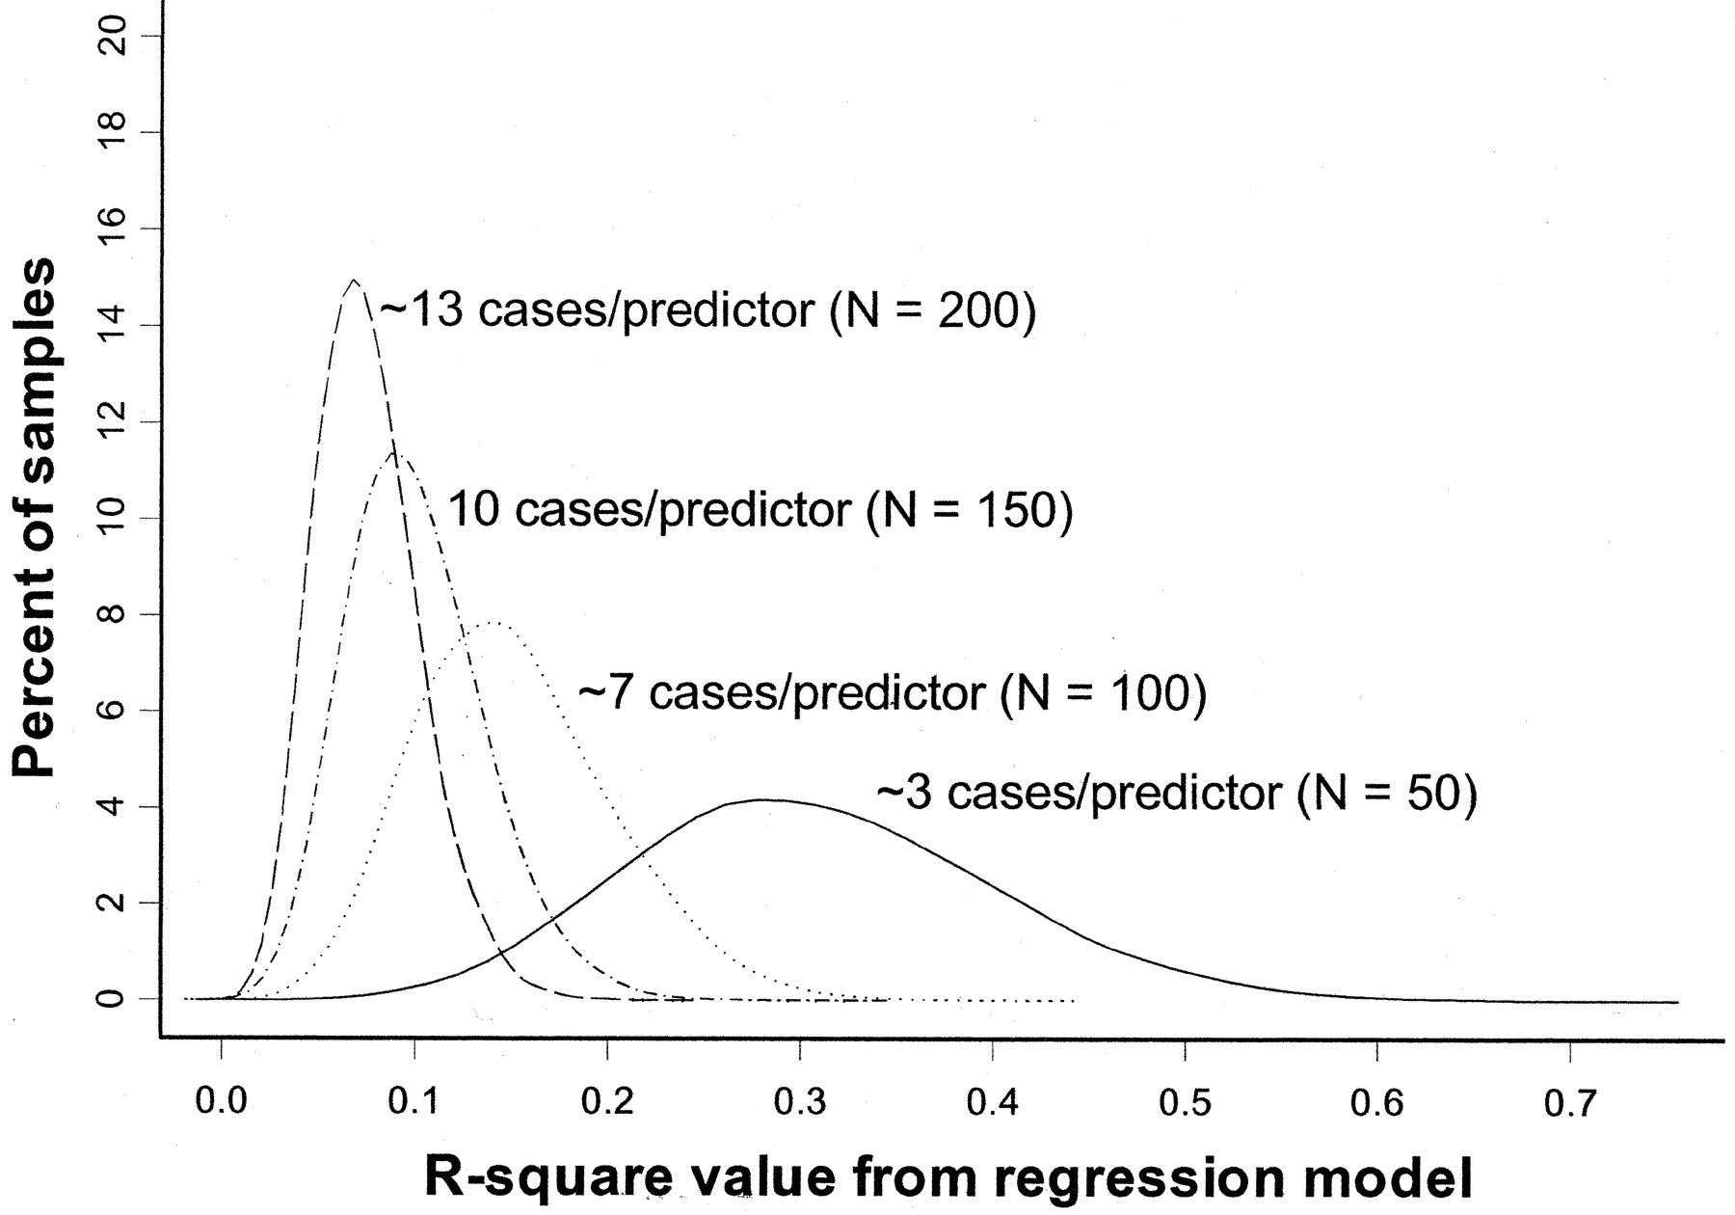
Overfitting simulation (where we know the ‘true’ population has R²=0)
All regression models in simulation have 15 predictors
True R² = 0
(Figure from: Babyak, MA. What You See May Not Be What You Get: A Brief, Nontechnical Introduction to Overfitting in Regression-Type Models. Psychosomatic Medicine 66:411-421 (2004).)
Notes:
The model contained 15 predictors, each consisting of randomly generated values, and a response variable, whose values were also randomly generated

Slide 120
Overfitting: 3 cases/predictor: mean R² looks like .3
R² distribution for 10,000 regressions based on 10,000 random samples of the data (N=50).
(Figure from: Babyak, MA. What You See May Not Be What You Get: A Brief, Nontechnical Introduction to Overfitting in Regression-Type Models. Psychosomatic Medicine 66:411-421 (2004).)
Notes:
Y axis is percent of sample distributions that had a given R2 value (for that N). X axis is distribution of R2 values across the 10,000 regressions (for that N)

Slide 121
Overfitting: 13 cases/predictor: mean R² looks like .05
R² distribution for 10,000 regressions based on 10,000 random samples of the data (N=200)
(Figure from: Babyak, MA. What You See May Not Be What You Get: A Brief, Nontechnical Introduction to Overfitting in Regression-Type Models. Psychosomatic Medicine 66:411-421 (2004).)

Slide 122
Summary
Introduced correlation analysis
Discussed correlation to measure the strength of a linear association
Introduced simple linear regression analysis
Calculated the coefficients for the simple linear regression equation
Addressed assumptions of regression and correlation
Addressed prediction of individual values
Discussed residual analysis
Adapted from http://www.fordham.edu/economics/Vinod/correl-regr.ppt

Slide 123
Summary
Regression tells us to what extent a group of independent variables predict or explain a dependent variable
It is based on the same assumptions as correlation
In addition, predictor variables that are not independent can mess it up
Over fitting can be a problem (too little data for the number of independent variables)

